Slide 1


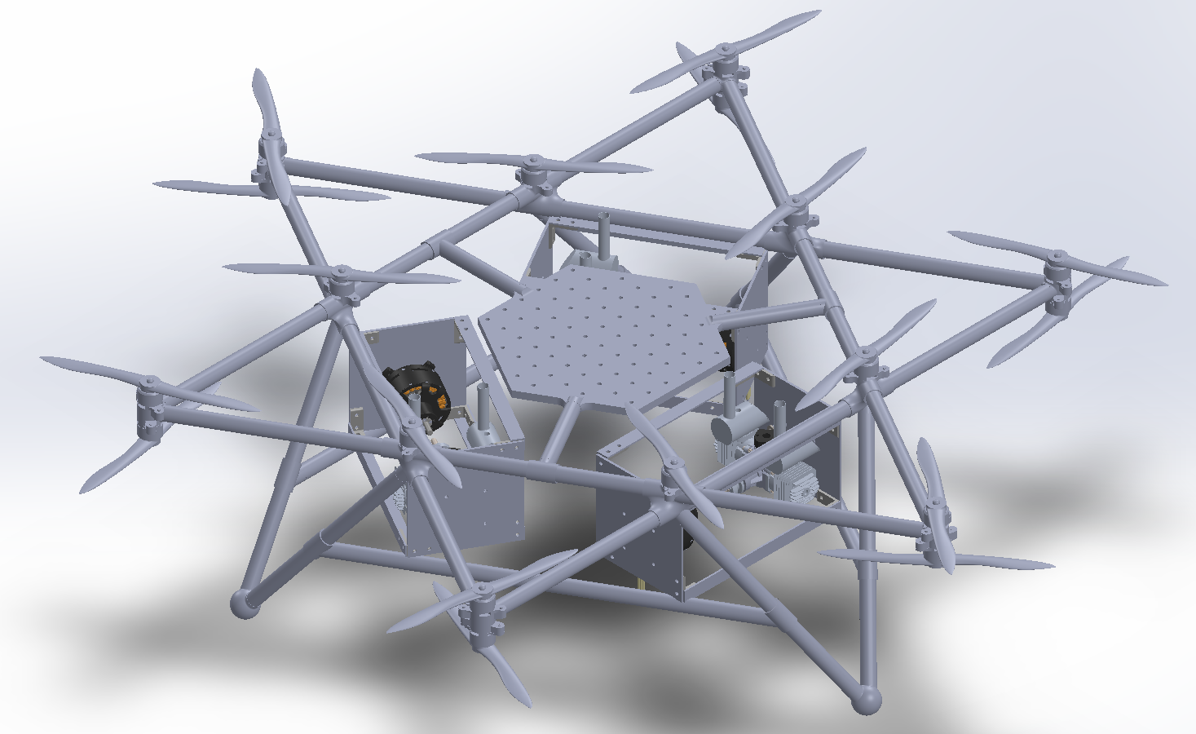
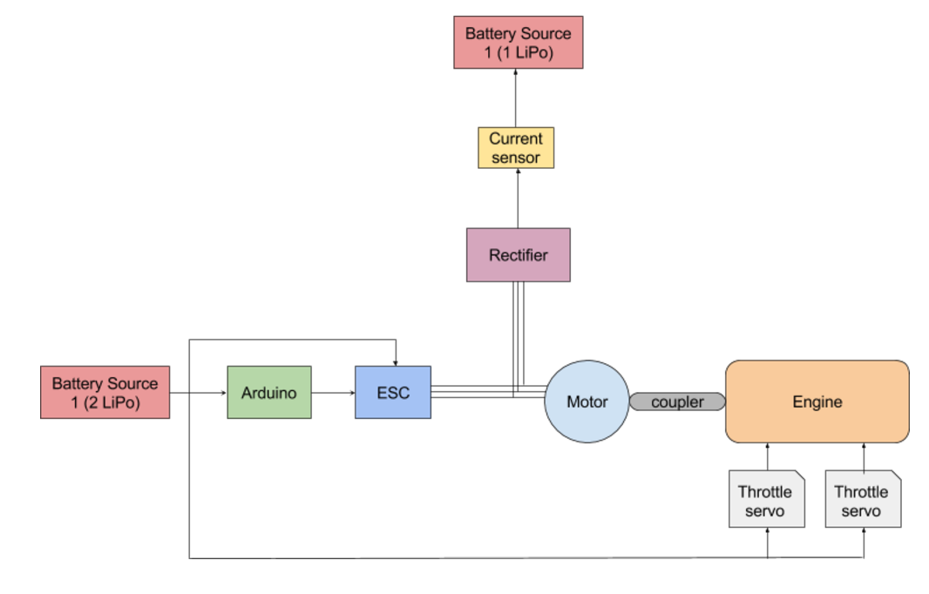
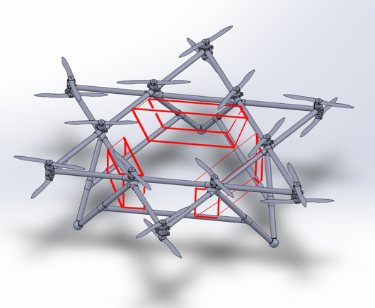
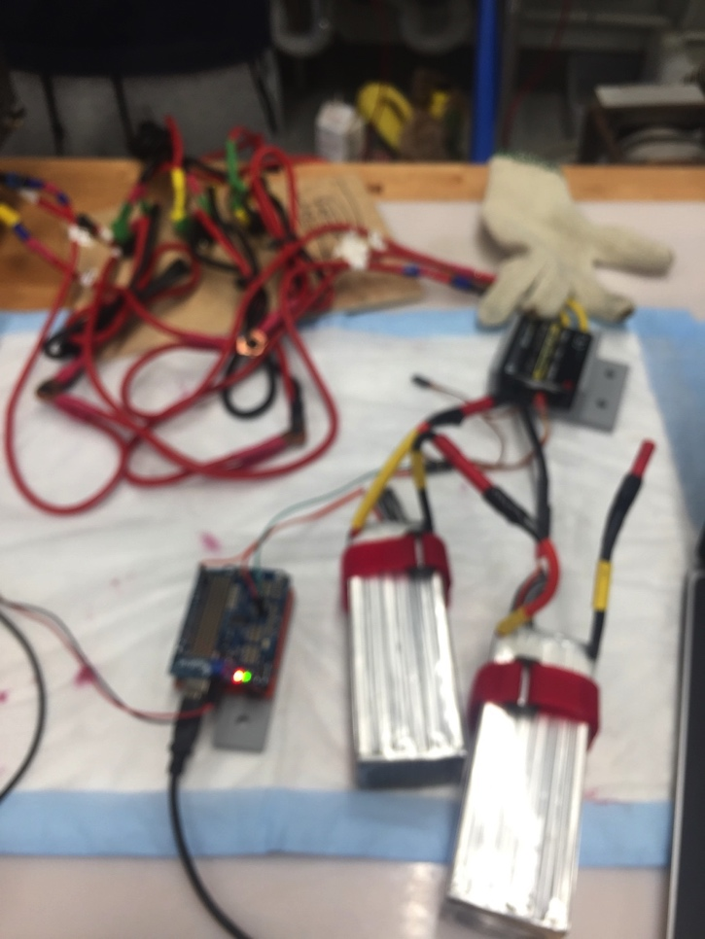
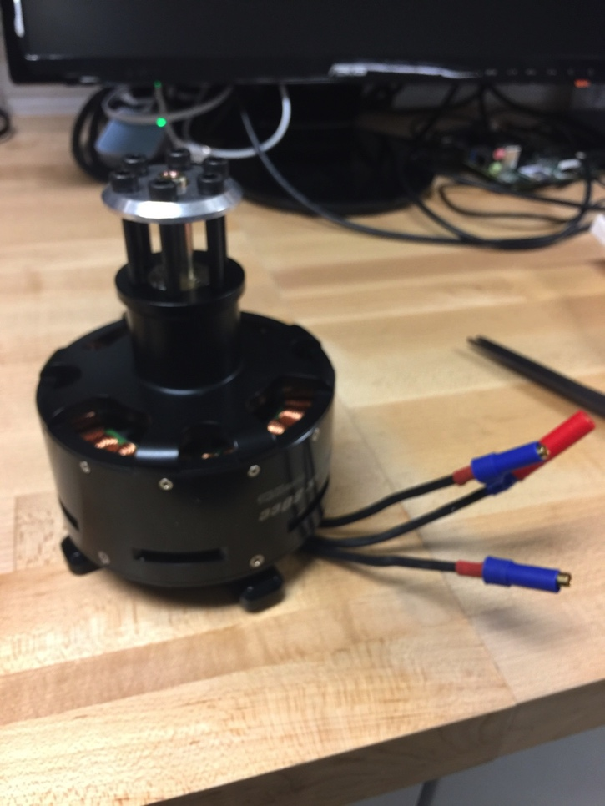
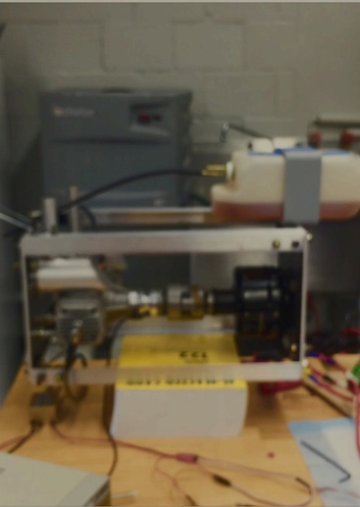
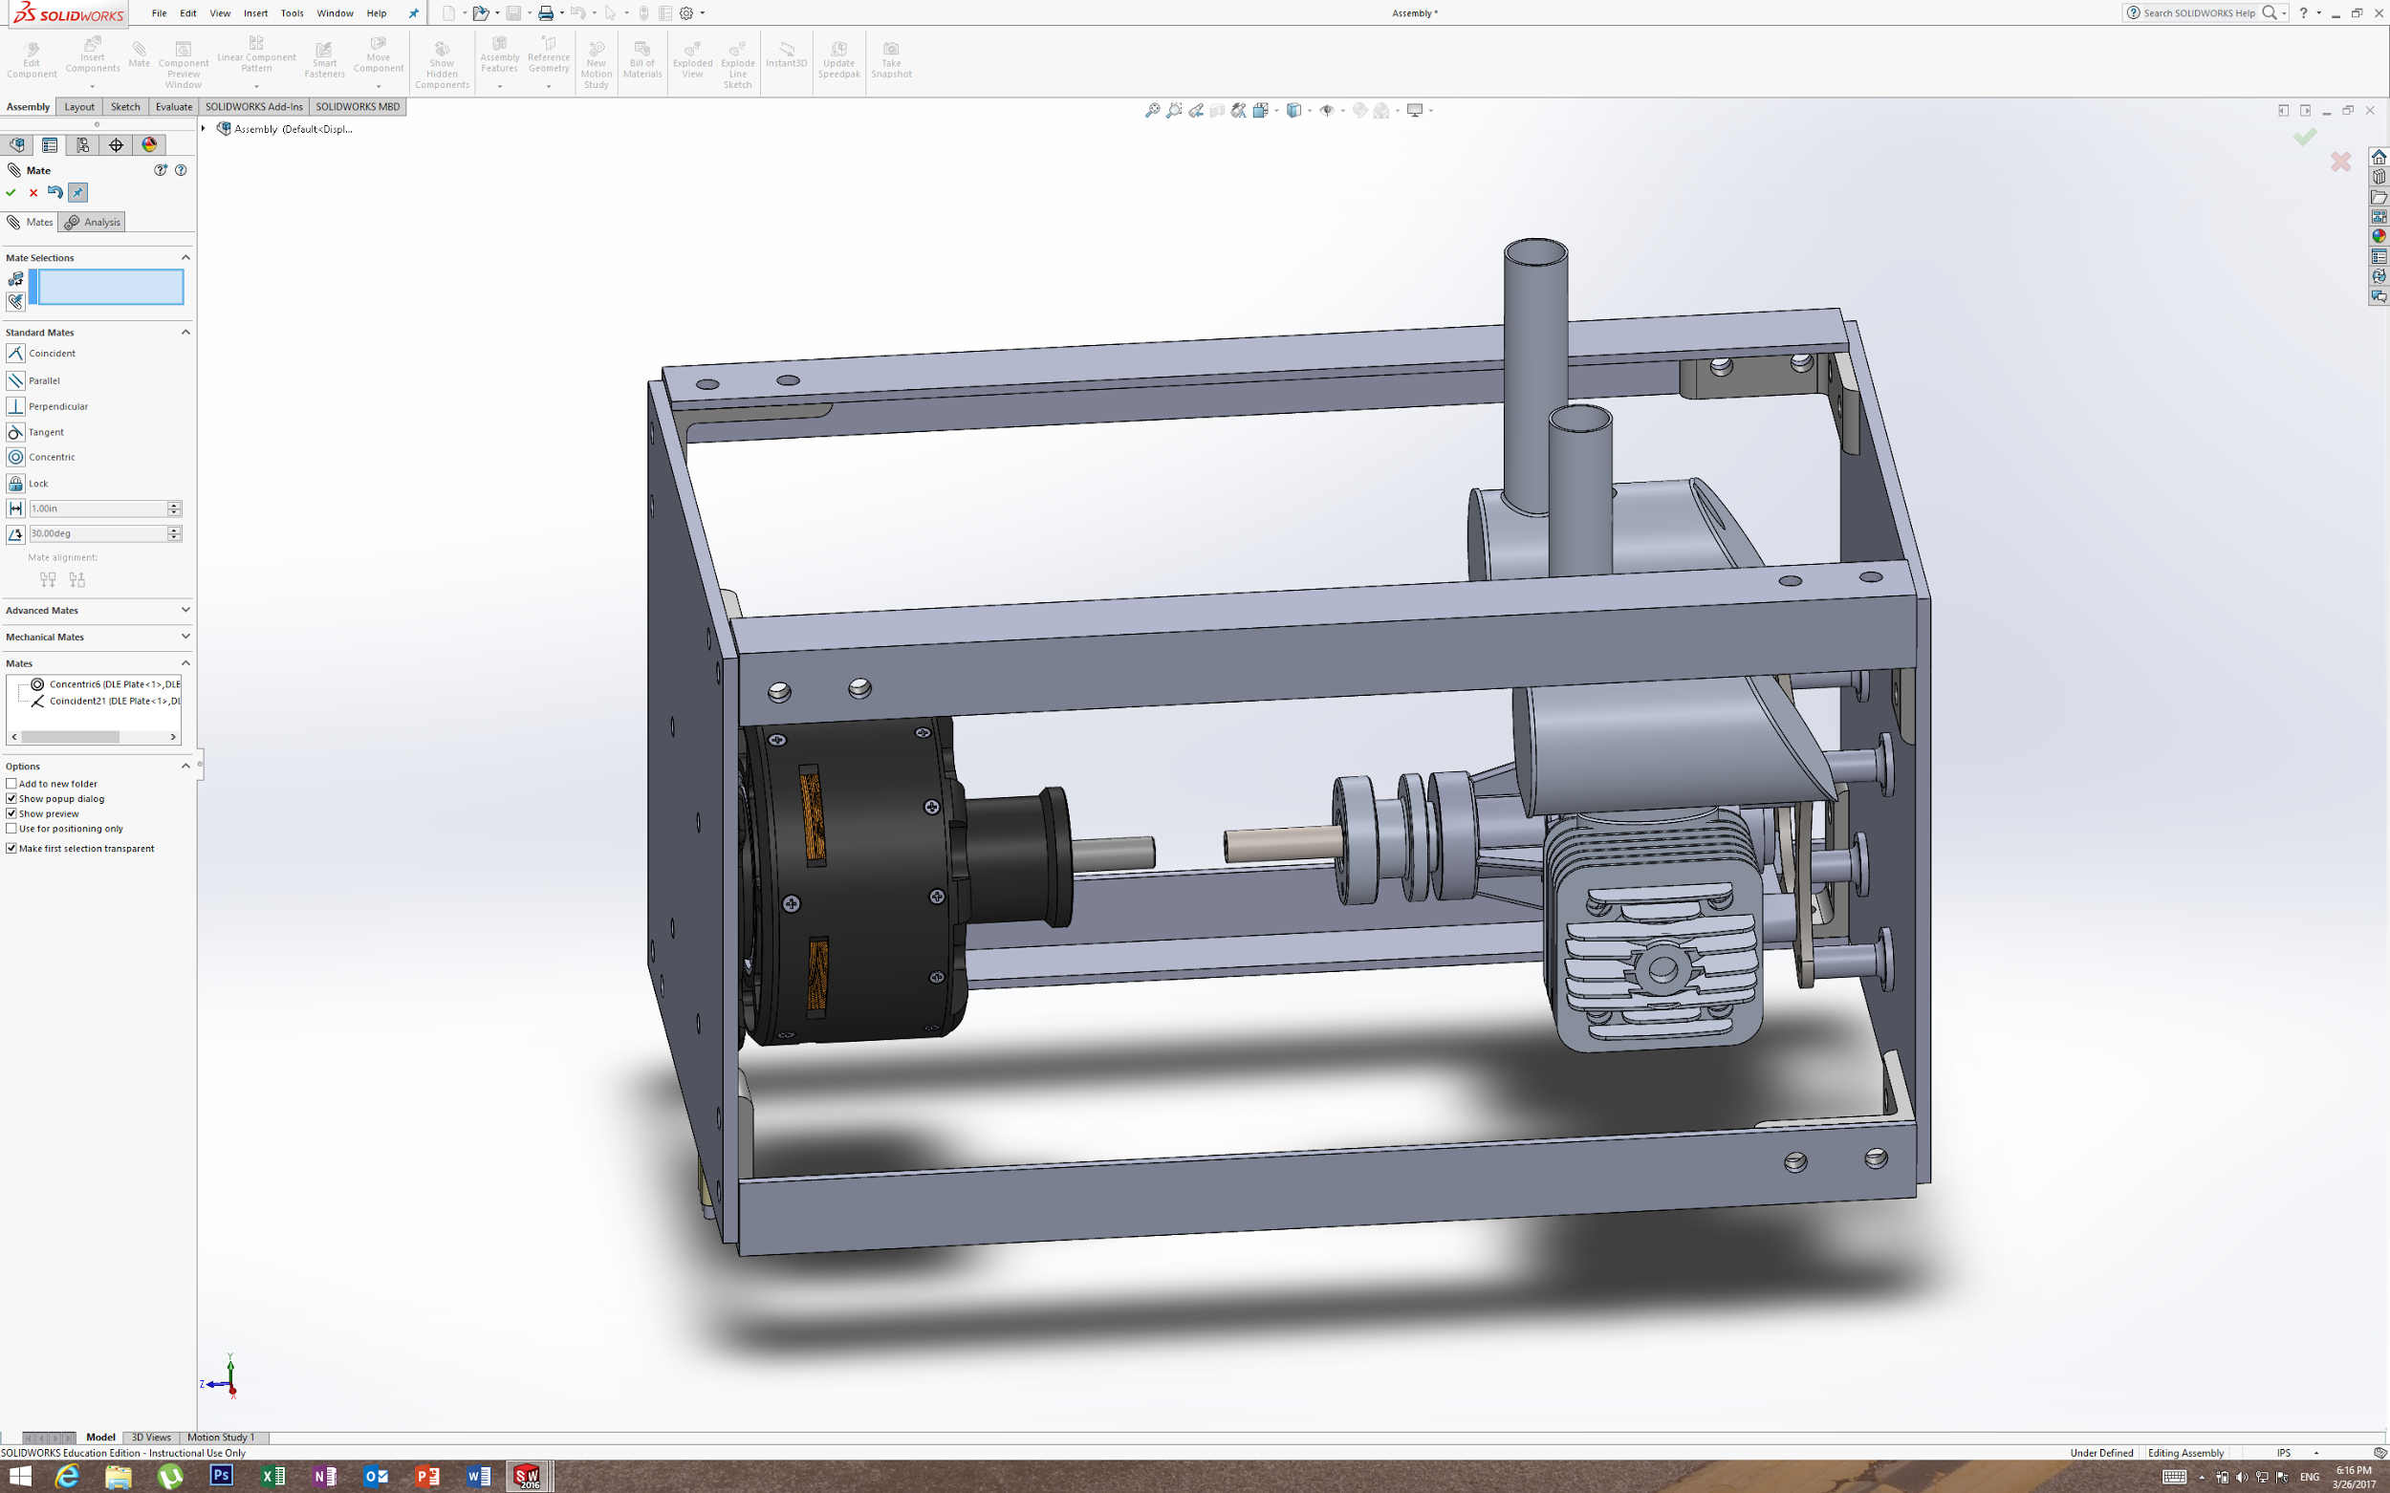
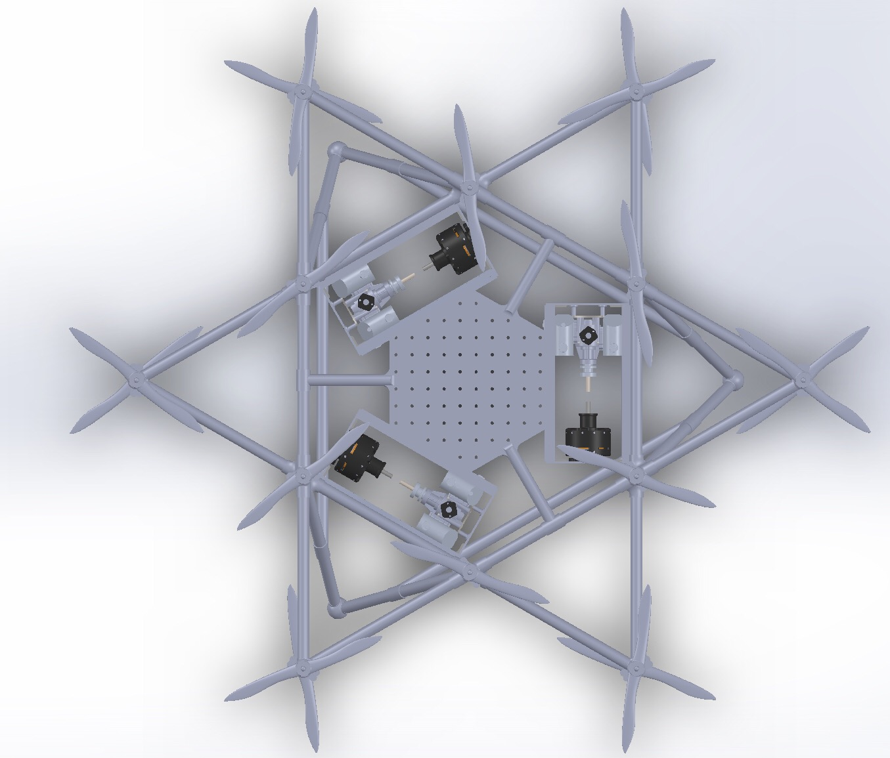
Hybrid Gas Electric Power System for a Heavy Lift Drone Nigel Malaba
Motivation and Project Objectives
Drone Body Design
Individual Contribution
This independent study is part of an ongoing project to compete in the Shell Ocean Discovery X-Prize global competition, the aim of which is to find a more efficient way of producing high resolution bathymetric maps of the ocean floor. A semi-autonomous device must be built that can map 500 sq. km of the ocean floor at depths of 2000-4000 meters. It was decided that an 18 rotor, heavy-lift drone equipped with a synthetic aperture solar diving pod capable of collecting seafloor data should be designed for the competition. To effectively function and complete such a task, the drone needs a lightweight, robust body, and a hybrid-gas electric power system, the focus of this project.
The primary considerations for designing the drone from a structural standpoint include: weight, durability, structural stability, and load capacity.
The drone must also be symmetrically loaded and be able to withstand potential unforeseen disruptions.
Due to its relatively low weight and high durability, carbon fiber tubing was used for the main body of the drone. 3D printed ABS plastic parts were used for the joints in order to allow replicability and a lightweight strong design.
The upper portion of the drone was chosen to be a hexagram frame and the bottom portion was designed with three triangular legs, which utilize the structural benefits that triangular geometries offer. Please refer to isometric view to the right for a SolidWorks rendering of the drone body.
These legs also allow for additional components such as the hybrid power system to be attached and symmetrically loaded.
Adjusted the Arduino code that controls the motor speed so as to slow down the motor: The motor was spinning too fast. This resulted in the MG set coupling coming apart each time we ran it. It was necessary that I adjust the code so that it sends a lower PWM to the ESC at each phase. I made it rotate up to less than the maximum speed possible.
Soldered new battery connections to supply a 44V power supply to start the motor: I had a setback in which I shorted the circuit once resulting in the LIPO batteries blowing up. After this incident, it was essential that I solder new battery connections for the new batteries which would then provide power to start the motor to start.
Troubleshoot and replaced all electrical components as needed including the electric motor: It was concluded that the motor we were using could have been damaged therefore I soldered connections for a new motor which was then used on the final system design. However this was not the problem, so a continuity test was conducted on all the electrical connections. The results of the continuity test showed that one of the wires connected to the Arduino board was shorted and this was replaced, resulting in the system running smoothly
Connected the load resistance consisting of heating elements to the system: 4 heating elements were purchased which were connected to the ends of the rectifier circuit as a load. The resistors enabled the output power of the system to be measured; by connecting the large resistance to the rectifier ends, the voltage drop across the resistors was measured using a voltage reader from which the current could be calculated. Overall, I worked with the team to ensure that the engine is running, as well as that it is generating enough torque to spin the motor.
Worked with the other group members to redesign the major components of the power system such as the frame so that the engine runs smoothly
Key Functional Requirements
Design machine shafts and a coupling method for the motor-generator (MG) set capable of handling the large amount of torque generated.
Build a frame and mounting system for the MG set that is sturdy, lightweight and mountable onto the body in the appropriate geometries for flight.
Perform Finite Element Analysis (FEA) on the MG set frame to ensure it can handle the stresses of running the set.
Test the output of the power system at varying loads
Design an alternative frame design in order to accommodate all required components, allow symmetrically balanced loading, and sufficient structural strength to endure a crash landing situation.
Reduce the speed of the motor such that the torque does not break apart the coupling of the MG set.
Software
The ESC shown on the circuit diagram to the left takes Pulse Width Modulation input. The speed of the motor is programmed purely as a function of the duty cycle. The higher the duty cycle, the higher the speed of the electric motor. The maximum speed used on the code maps to 2 milliseconds or 2000 microseconds. In the start up sequence, the motor is programmed to start at 1000ms and slowly ramps up to 1200ms. This is sufficient speed to spin the motor at the same time not providing too much torque to disassemble the shaft. There are 4 phases to which the speed goes up to, with phase 1 being the lowest speed. The amount of time spent on a particular speed was determined by the delay which was mainly 1500, an equivalent of 5 seconds. Therefore the motor ran for 20seconds before acting as a generator. In order to check that the ESC was working, an oscilloscope was used to check the square wave generated by the Arduino.
A better method of controlling the speed of the motor involved calling the mapping function called writemicroseconds() that does all the calculations. The function receives an input percentage from 0 to 100 and calculates the pulse length which is then sent directly to the ESC. This is more efficient because it does not involve estimation of the PWM values.
The code was run by verifying, compiling and opening the serial monitor from which printed values of the exact PWM and phase sent to the ESC were displayed The other parts of the code involve calibrating the movement of the throttle/choke servos by finding the pulse lengths/angular positions that correspond to the throttle and choke valves being fully open or closed.
Hybrid Power System Design
The hybrid power system consists primarily of brushless DC motor/generator coupled to a DLE-60 twin cylinder engine, both of which are mounted to a frame of 6061 Aluminum. Two 22.4 V, 4500 mA H lithium potassium (LiPo) batteries are used to start the motor and run the engine. The power generated flows through a rectifier circuit and charges one LiPo battery. A full schematic of the components is shown below.
The design for the power system employs a gas engine coupled to a DC motor, and a significant amount of torque is generated. Arduino code was used to program the power system by sending PWM impulses to the ESC which then controlled the speed of the motor as well as started the engine by regulating the throttle/choke valves.
https://docs.google.com/document/d/1wcFQonSCTwOSvjcp4_RewytC23nD_s9eHOoJ1f-UhME/edit#

